Slide 1
Міжнародний науковий рецензований електронний журнал: створення та просування
Тетяна Андрєєва

Slide 2
How to establish and to run a peer review journal
Tatiana Andreeva,
School of Public Health,
National University of Kyiv-Mohyla Academy Mailto: tatianandreeva@yandex.ru

Slide 3
Rhetoric questions
  Which requirements to follow?
    international?
    national?
  What kind of a journal to choose?
    open access?
    print/subscription?

Slide 4
Real questions
How to establish?
What to start with?
How to get the audience?
How to get the authors?
Where to get the reviewers?
Who will be the Editorial Board?
How to fund the enterprise?

Slide 5
Prerequisites:
What you need in advance
Yourself with an extensive experience of publishing in peer-review journals and reviewing for them
A group of authors who want to publish internationally
At least five articles written by these authors according to the requirements of international journals but not yet published
A web page you can administer yourself
A computer and software to edit, to prepare layout, and to develop web pages

Slide 6
First steps
Prepare layout of the articles and the table of content
Prepare a mock cover page and editorial pages
Post the issues online
Get ISSN

Slide 7
ISSN
What you need
  Cover page
  Editorial page
  Table of content
  online:
    ‘About the journal’
    ‘Contact information’
    your published issues and articles

Slide 8
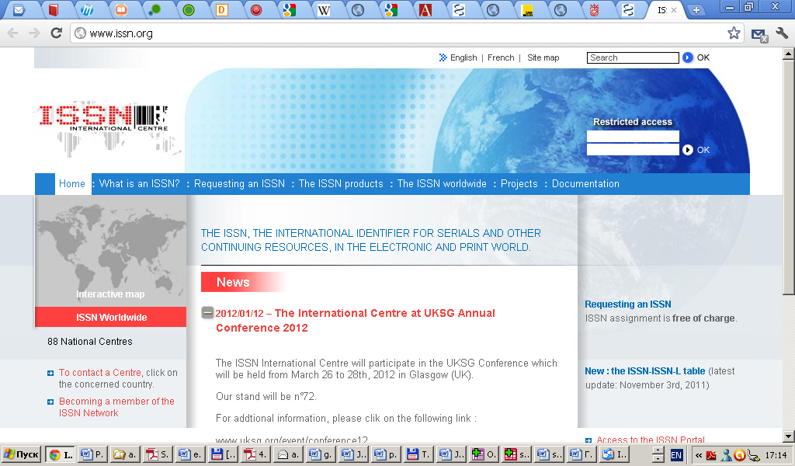
http://www.issn.org/

Slide 9
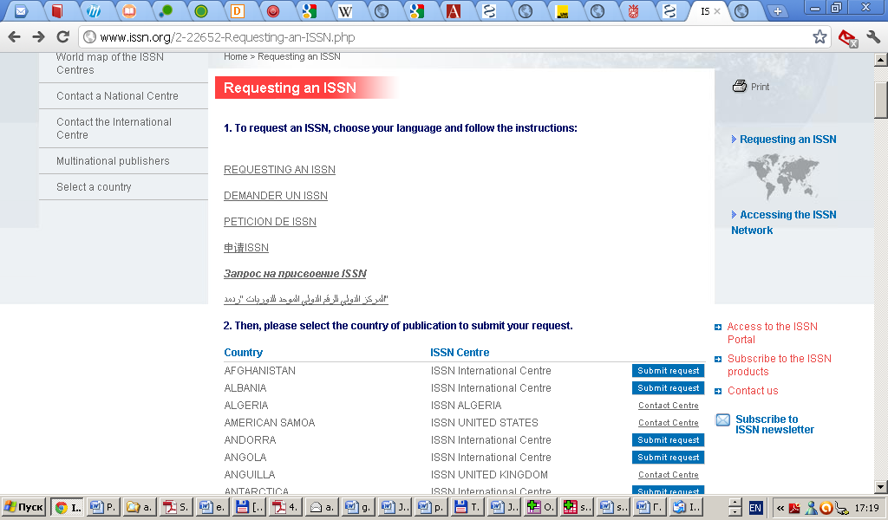

Slide 10
Next steps
Make your journal web-page visible for Google Scholar
Register at the Directory of Open Access Journals
Explore other indexing systems and register

Slide 11
Google Scholar
Requirements are clearly described online
Your content becomes searchable in four weeks

Slide 12

http://scholar.google.com/intl/en/scholar/about.html

Slide 13
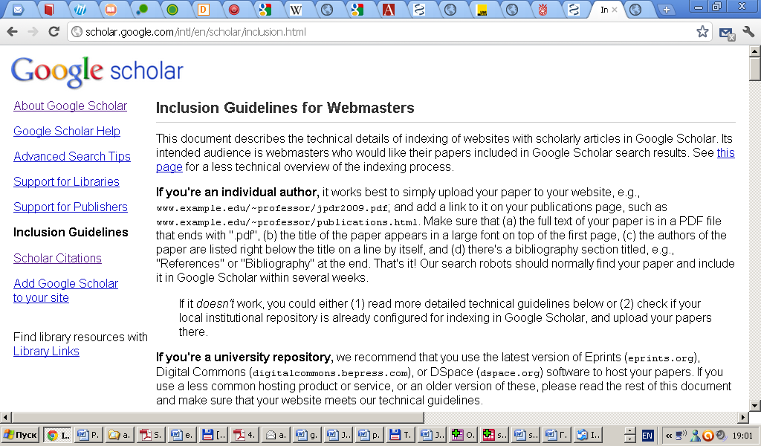
http://scholar.google.com/intl/en/scholar/inclusion.html

Slide 14
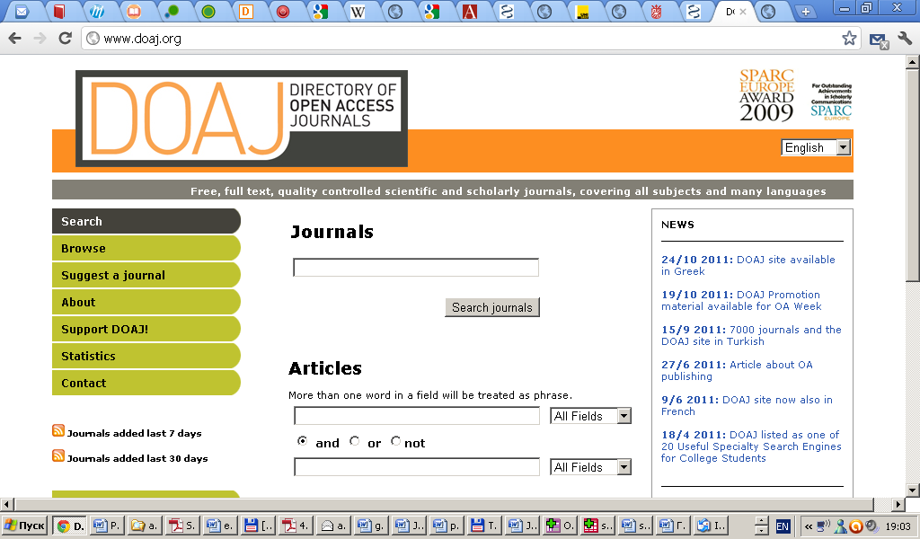
Directory of Open Access Journals

Slide 15
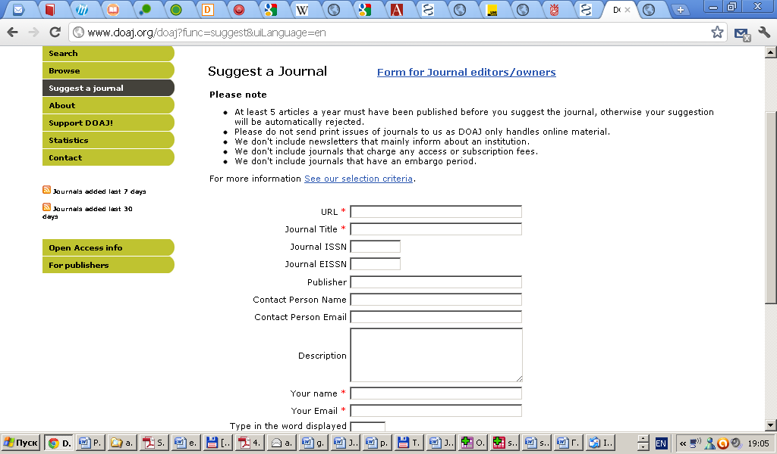
http://www.doaj.org/doaj?func=suggest&uiLanguage=en

Slide 16
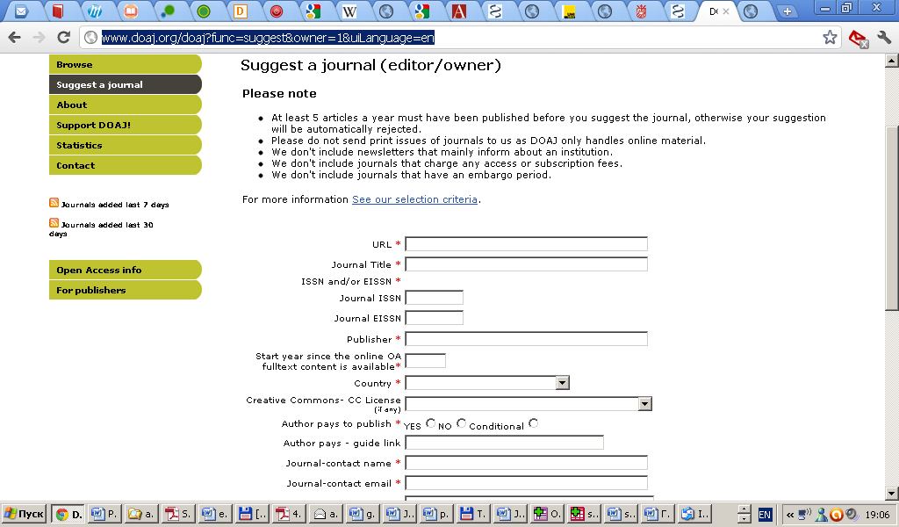
http://www.doaj.org/doaj?func=suggest&owner=1&uiLanguage=en

Slide 17
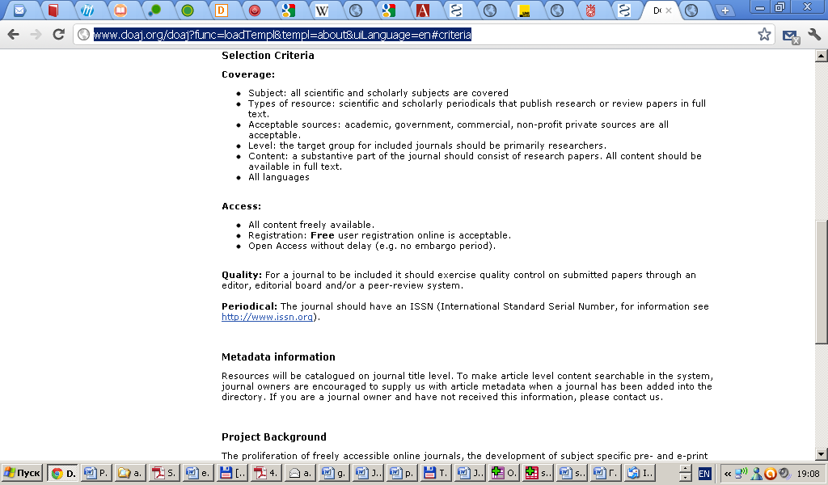
http://www.doaj.org/doaj?func=loadTempl&templ=about&uiLanguage=en#criteria

Slide 18
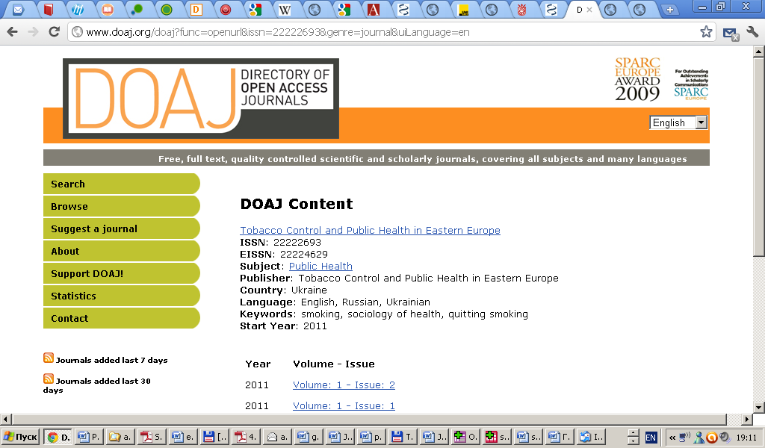
Results in four months

Slide 19
Other indexing systems
TCPHEE is indexed in:
Google Scholar
Directory of Open Access Journals
CAB International
JournalSeek
Index Copernicus
Directory of Open Access Repositories
Registry of Open Access Repositories
OAIster
Academia.edu
elibrary.ru
SHERPA/RoMEO

Slide 20
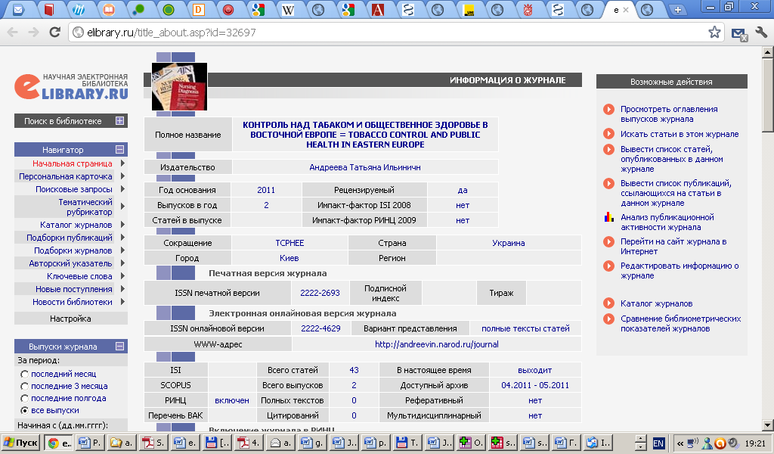
elibrary.ru

Slide 21
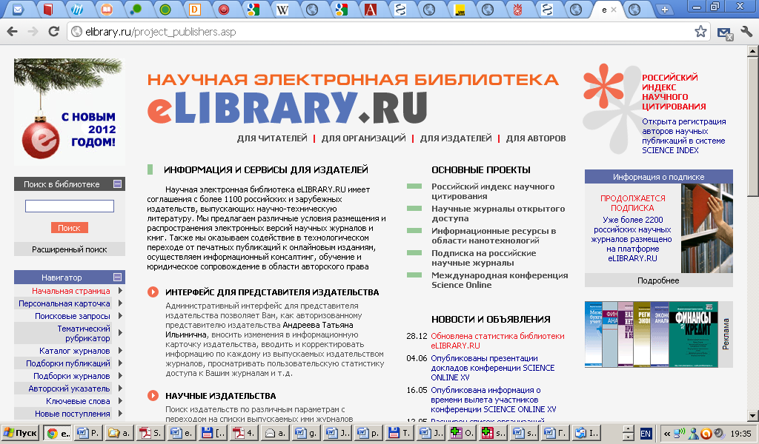
http://elibrary.ru/project_publishers.asp

Slide 22
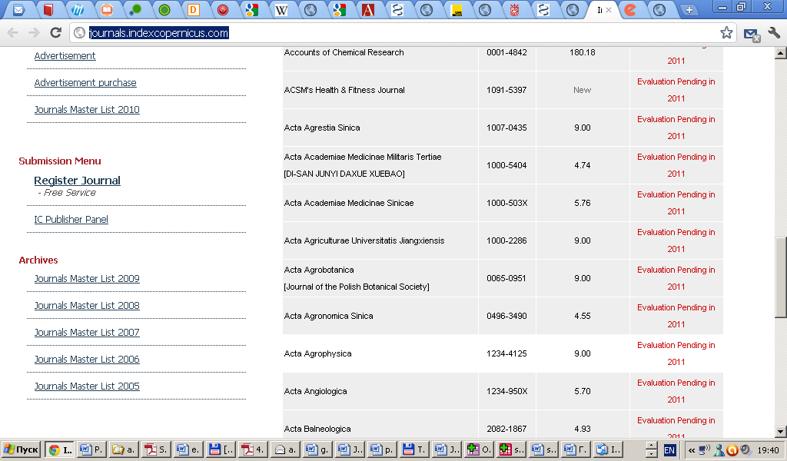
Index Copernicus http://journals.indexcopernicus.com/

Slide 23
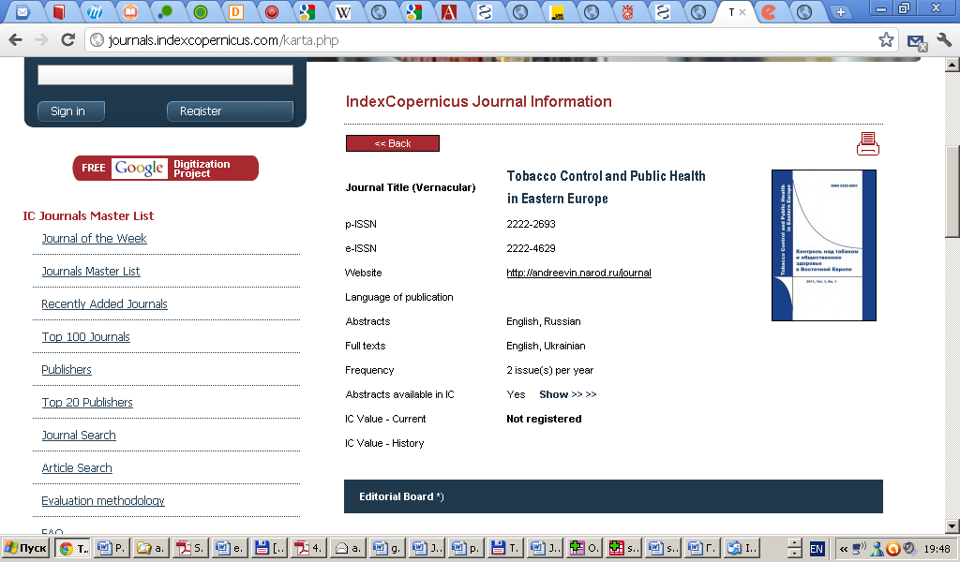

Slide 24
Current situation
Additional indexing
Academic Journals Database
EBSCO
HINARI
Additional Serial registries
ISSN
ulrichsweb.serialssolutions.com
Free medical journals. Substance abuse
tdnet.com
Serials Solutions, Inc.
ExLibris Inc

Slide 25
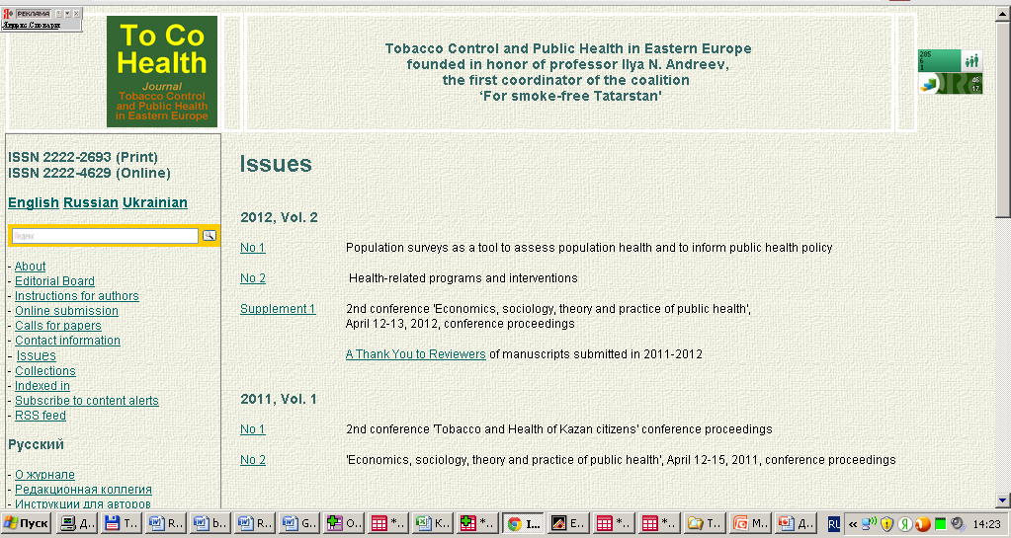
http://andreevin.narod.ru/journal

Slide 26
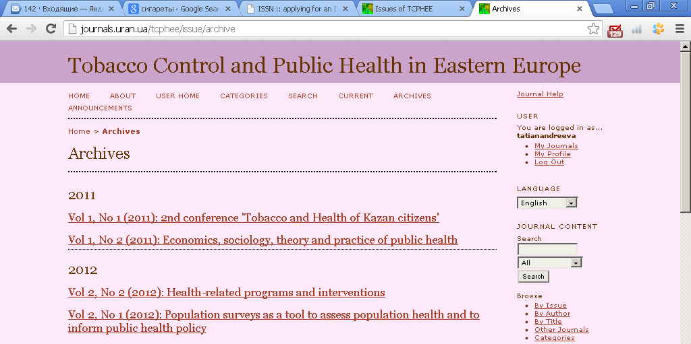
http://journals.uran.ua/tcphee

Slide 27
Further steps
SCOPUS
  9 papers at least
  two years
Medline/PubMed
  20 papers at least
Thomson Reuters Science Citation Index
  3 consecutive issues
General requirements
  original content
  peer-review quality control
  international geography of authors and the Editorial Board
  bibliography in Latin alphabet
  publication ethics
  timeliness of publication

Slide 28
Other issues of journal functioning
Authors
  whom to invite
  how to motivate
Reviewers
  difficult to find reviewers in other languages besides English
  how to motivate reviewers to collaborate
Editorial Board
  very important and busy people
Money
  social service or a business project?

Slide 29
Запитання?
Андрєєва Тетяна Іллівна
email: tatianandreeva@yandex.ru

