Slide 1
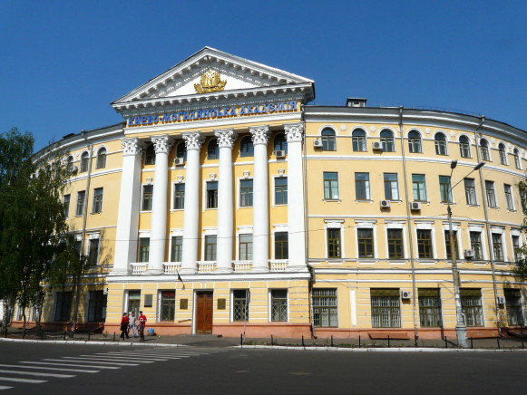
Types of assignments recommended during RDM
practice training for PhD students in Ukraine
Svitlana Chukanova, Ph.D.(Ed),
Head of Research Library Sector
American Library Coordinator at the National University of Kyiv-Mohyla Аcademy
Notes:
Source Image:-
https://pixabay.com/photos/business-professional-teamwork-1219868/

Slide 2
RDM training
The course on Research Data Management training is an essential part of Ph.D. studies in the modern educational context. The practice of research data management is quite new to Ph.D. students in Ukraine who are at the beginning of their academic careers and who just have started their journey in acquiring and developing transferable skills.

Slide 3
RDM is…
Ottawa University Library defines RDM as “…the active organization and maintenance of data throughout the research process, and suitable archiving of the data at the project’s completion. It is an on-going activity throughout the data lifecycle.” This statement means that RDM is a process which lasts during the research project and has several stages that corelate with research data lifecycle stages. It is important to mention that RDM is a cooperation between the national policy of research data processing, institutional policy, library, and the researchers themselves as they are main figures in delivering the research project and gathering the data.
https://biblio.uottawa.ca/en/services/faculty/research-data-management/what-research-data-management

Slide 4
RDM elements in Ph.D. training at NaUKMA
Since 2009, The National University of Kyiv-Mohyla Academy (Kyiv, Ukraine) (NaUKMA) offers the course "Digital Science and Information Literacy" within the NaUKMA Doctoral School curriculum.
It includes modules on scholarly communication, information literacy, scientometrics, scholarly publications quality criteria, academic integrity, research ethics, Open Access, Open Science, research data management, the use of reference managers, requirements for writing scientific papers. The modules on academic integrity and research data management were introduced into the program in 2018.

Slide 5
RDM elements in Ph.D. training at NaUKMA
In 2019 NaUKMA, in partnership with FOSTER Open Science and Clarivate Analytics, developed, recorded in studio, prepared, and launched the MOOC "Scientific Communication in the Digital Age" on the Ukrainian online course platform "Prometheus".
The course is almost identical to the postgraduate course described above and consists of 13 modules, 2 of which are devoted to research data management basics and data management planning.

Slide 6
Further development of the topic
Communication with Ph.D. students has shown the need to develop a separate course on research data management, which is in plan currently. A selective course "Research Data Management“ will have approximate structure as follows:
Topic 1: The importance of research data management.
Topic 2. The concept of "research data", types and kinds of research data.
Topic 3. Research data life cycle and basics of research data management.
Topic 4. Data organization and naming rules.
Topic 5. Research data management plan.
Topic 6. Addressing ethical issues when working with data and quoting data.
Topic 7. Working with repositories for long-term data storage.
Final test.

Slide 7
Competencies students will acquire after learning RDM course
According to L. Corti, V. Van den Eynden, L. Bishop, M. Woollard, and other authors of “Managing and sharing research data. A guide to good practice”, the learners will have the certain competencies after completing the following RDM course modules:

Slide 8
Competencies students will acquire after learning RDM course
Why managing and sharing data is important?
Research data lifecycle.
RDM Planning process.
How to provide context for data?
Processing the data (format, organize, transform).
How to store and move the data?
Ethics and legal aspects of data sharing.
Data security aspects, data protection.
Research Data related rights.
How to use other authors’ data.
How to publish and cite the data.
Big Data aspects.

Slide 9
Types of assignments to train RDM competencies
Exercise example | What it should train
According to Cristine Borgman distinguish between different types of research data. Construct a comparative table where sort out the certain data types between the categories: numeric, textual, visual, etc. | Understanding of research data types. Ability to distinguish between them. Ability to categorise and classify research data.

Slide 10
Types of assignments to train RDM competencies
Exercise example | What it should train
Regard and compare several variants of research data lifecycle. Indicate what do they have in common and what is different. (As an example, students may use DataOne and Edinburgh University materials on data lifecycles or any other organisations they choose) | Awareness that there are a lot of research data lifecycle schemes Ability to differentiate between research data lifecycle steps and what RDM actions are performed in terms of each step.

Slide 11
Types of assignments to train RDM competencies
Exercise example | What it should train
Fill out research data management plan with use of DMPTool or DMPonline instruments | Ability to compose RDM plan with help of special open source tools. Understanding of the requirements to RDM plans from different funding agencies.

Slide 12
Types of assignments to train RDM competencies
Exercise example | What it should train
Indicate metadata to your dataset and compose readme file to it. (Consult the resource https://www.dcc.ac.uk/resources/curation-reference-manual/chapters-production/scientific-metadata ) | Ability to prepare metadata according to a particular dataset.

Slide 13
Types of assignments to train RDM competencies
Exercise example | What it should train
Prepare a dataset based on your research project using only open formats. Indicate what are the formats considered as open. What are the pluses and minuses of open formats? Use one of the open file renamers by applying your file naming schema and describe the principle of its work. | Understanding the importance of open formats for better data sharing in the research community. Understanding the principle of automatization in research data processing. Understanding of file naming conventions and version control.

Slide 14
Types of assignments to train RDM competencies
Exercise example | What it should train
Use re3data.org registry and find data repository specific to your research or field of studies. Create a profile on Mendeley data and deposit your data package with use of metadata you created previously. Provide a readme file to your data set and include it onto your data package | Ability to find data repository which covers your needs in data sharing in terms of your research field. Ability to use data repositories for research data sharing.

Slide 15
Types of assignments to train RDM competencies
Exercise example | What it should train
Compose an essay on the topic “The importance on personal data processing consent in terms of human subject research” | Understanding the importance of personal data security and research integrity, and ethics.

Slide 16
Types of assignments to train RDM competencies
Exercise example | What it should train
Find several datasets related to your research on OSF portal and provide a bibliographic description (references and in-text citations) for these data packages in APA style. | Understanding the importance of data packages citation. Awareness of the fact that data authors must be attributed as well as the authors of printed articles or books, etc.

Slide 17
Types of assignments to train RDM competencies
Exercise example | What it should train
Try one of the Open Science tools: GitHub, Jupyter Notebooks, and RStudio IDE, Google Data Studio, Tableau Public. | Ability to use open tools for Data Science

Slide 18
Questions examples for additional studies:
What is Big Data, how it can be gathered and analysed in your field of study?
What tools for visualisation do you know, how would you compare them by indicating their strong and weak sides?
What types of research data are peculiar to your research project?
Does your research include humans as research subject? If yes, what are the GDPR regulations are apply in that case?
What RDM activities apply for each research data lifecycle stage in terms of your research?
What data repositories useful in your field of research?

Slide 19
Questions examples for additional studies:
Explain the difference between thematic and institutional data repositories?
What is seal of approval and how it influences trustworthy of data repository?
What back up strategies for data may apply in your research?
How are you going to provide data security?
How would you prevent the leak of the research data?
What is OSF platform and how it functions?
What is version control?
Analyse naming conventions according to MIT Libraries Data Management Services^{[1]}.
Analyse Frictionless Data tools^{[2]}.

Slide 20
Conclusion
Students and researchers should bear in mind that there are various types and approaches to describe research data lifecycle, so, it is important for the instructor or lecturer to explain this variety and to choose one or a few lifecycle models which will be used during the course. Course participants must learn the connection between the lifecycle components to the activities provided during the data management and sharing process as each lifecycle stage will correspond with some activities of RDM at a certain period of research performance.

Slide 21
Questions & Answers

Slide 22
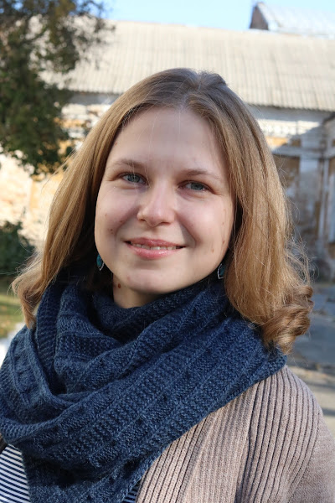
chukanovaso@ukma.edu.ua
THANK
YOU!

